Slide 1
Eratosthenes
284 - 192 BC
Journey Through Genius Pp 114
Notes:
After Archimedes left his long shadow cast on the world of mathematics, few mathematicians measured up
Syracuse fell to the Roman Marcellus in 212 BC, three bloody Punic wars ended with Rome’s destruction of its rival Carthage in 146 BC, ensuring Roman controlling on both sides of the Mediterranean, that same year, the last Greek city, Corinth, yielded to Roman power.
A century later Julius Caesar conquered Gaul in 30 BC, and after the unsuccessful stand of Anthony and Cleopatra, Egypt fell to the Romans at the hands Octavian. Barbarian Britain came under Roman control in 30 AD.
Rome was now officially an empire, they had domination over the western world.
Roman conquest brought sophistication to the world of engineering, with bridges and roads and aqueducts traversed the European landscapes, but the abstract, pure mathematics world was left untouched as it had been by the former glorious Greek men.
The great Library of Alexandria was left untouched, and there, a contemporary of Archimedes, Eratosthenes spent most of his life as the chief librarian
He was known as a widely read scholar, he studied pure mathematics, philosophy, geography, and astronomy
He produced a long poem called Hermes that put the fundamentals of astronomy
Archimedes himself dedicated at least one of his works to Eratosthenes
One contribution was his “sieve”, a way to find prime numbers
*example of the sieve from 2-50**
His greatest accomplishment was calculating the circumference of the Earth
The original treatise was lost, but tradition suggests that he used some geographic data as well as a simple bit of geometry
**read the excerpt on his calculation**
Ultimately his calculation led to about 24,466 miles, the currently accepted figure is 24,860 miles
This figure is so close to accurate, scholars have questioned the authenticity
What is most noteworthy is not only the accuracy of his calculation, but also the fact that, without doubt he believed the world was a sphere, when centuries (15) later European sailors feared falling off the edge of the earth.
“If later sailors kept a keen eye peeled for the horizon’s edge, it was a symptom not of knowledge yet to be acquired but of knowledge lost” JTG 116

Slide 2
Post-Archimedes
Few mathematicians measured up in the coming times after Archimedes
Syracuse fell to the Roman Marcellus, Corinth fell to Roman power, Romans had control on both sides of the Mediterranean
A century later, Caesar conquered Gaul, and Egypt fell to the Romans
Rome was then officially an empire
Romans brought sophistication to the world of engineering with roads, bridges and aqueducts, but the world of pure mathematics was left untouched

Slide 3
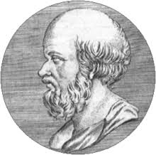
Eratosthenes
A contemporary of Archimedes, he spent most of his life as the chief librarian at the great Library of Alexandria
Studied pure mathematics, philosophy, geography and astronomy
He produced a long poem. Hermes, regarding the fundamentals of astronomy
Archimedes dedicated at least one of his works to Eratosthenes

Slide 4
Contributions
One important contribution is the Sieve of Eratosthenes, which we still see today in number theory courses
His greatest accomplishment was calculating the circumference of the Earth
We will examine his calculation, but first it is worth noting that Eratosthenes and many other ancient mathematicians and astronomers knew without a doubt that the Earth was a sphere, when centuries later Europeans were convinced otherwise and feared falling off the edge of the planet.
“If later sailors kept a keen eye peeled for the horizon’s edge, it was a symptom not of knowledge yet to be acquired but of knowledge lost” Pp 116

Slide 5
Variables & Assumptions
In the town of Syrene, south of Alexandria, the sun stood directly overhead, confirmed by the fact that an observer peering into a well was blinded by the reflection.
At the same time, same day, a pole in Alexandria cast a shadow, the angle of this shadow was assumed to be 1/50 of a whole circle
Assuming Alexandria was due south of Syrene, and the sun was so far from the Earth that its rays arrive in parallel lines
He concluded from Prop I.29 of the Elements that alternate interior angle AOS was likewise equal to the angle cast by the shadow
The final piece, known geographical fact that Syrene was 5000 stades away from Alexandria

Slide 6
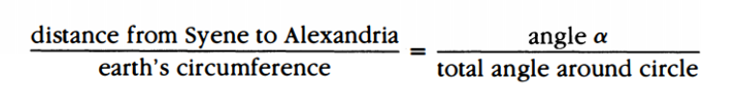
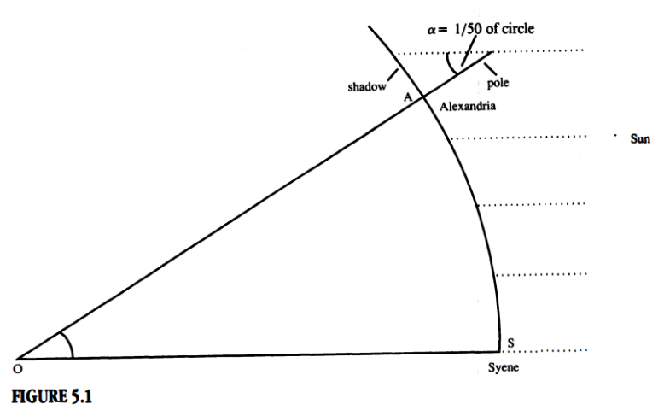
He arrives at the Earth’s circumference being 250,000 stades.

Slide 7
Which brings up… How long is a stade?
According to Eratosthenes, the circumference is 129,182,500 ft or 24,466 mls.
The currently accepted figure is 24,860 miles.
Approximately 516.73 ft

